Slide 1
Vertexing analysis
The goal of this study is to compare:
Event vs Jet level vertexing – event level is better
AVR vs Displacement vertex ordering – displacement is better
Figures that will be presented:
Number of vertices per jet – event/jet level
Number of tracks per vertex – event/jet level
Displacements of primary and secondary vertices
Fraction of tracks in primary vertex

Slide 2
Data
All histograms are created from ~14k bb~ jets and ~14k dark jets.
All vertexing was done with avr algorithm with default settings.
Jet deltaR = 0.7.
Vertices are sorted by displacement.

Slide 3
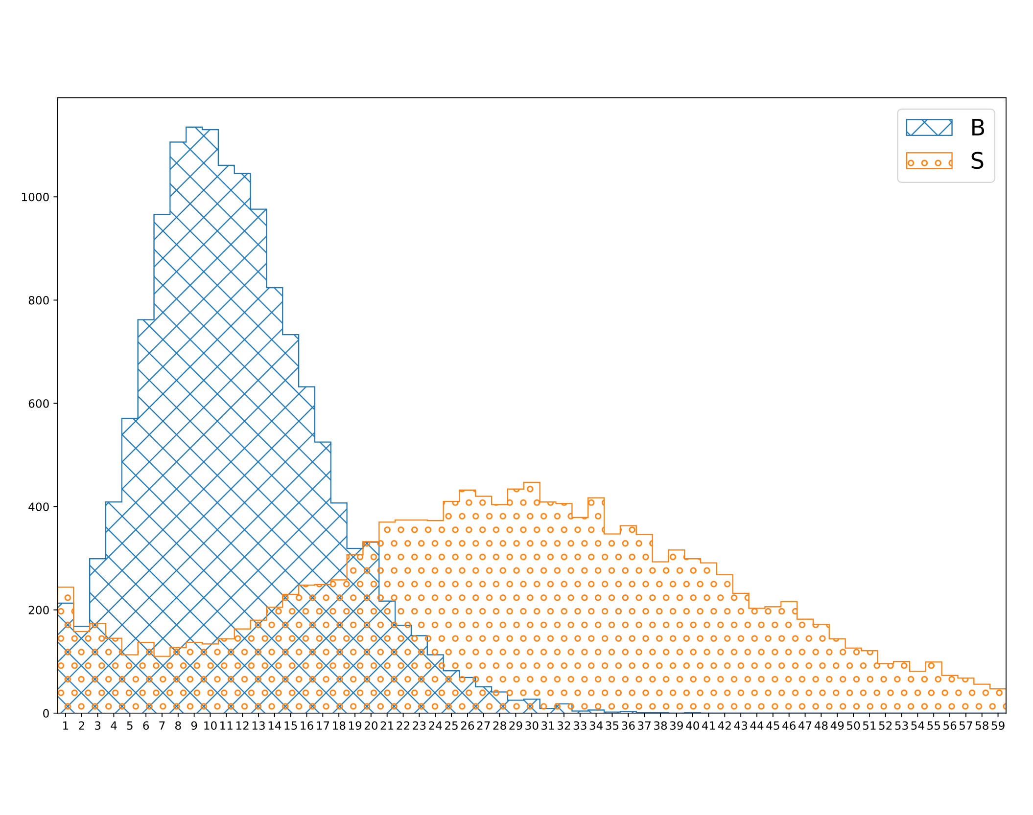
Track multiplicity
Signal has ~30 tracks whereas background has ~10 tracks.

Slide 4
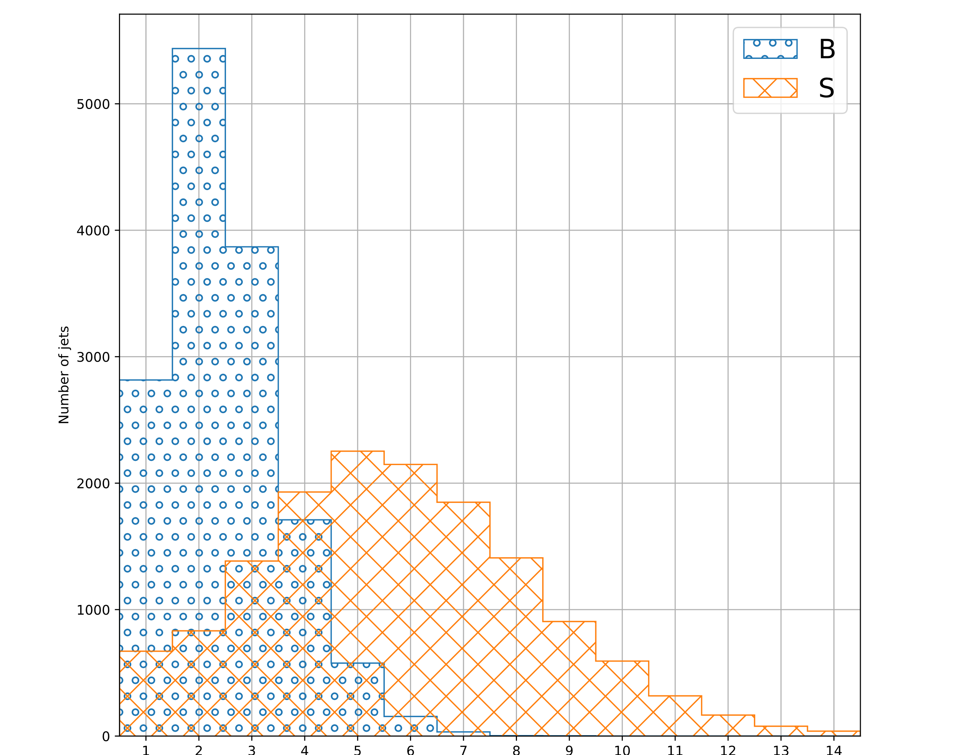
Vertices per jet
Signal has ~6 vertices whereas background has ~2 vertices.

Slide 5
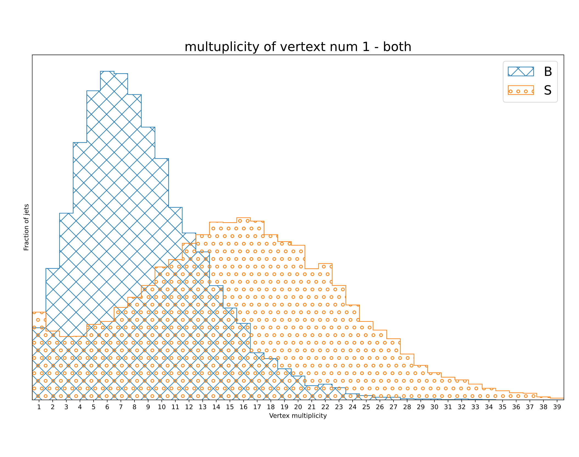
Primary vertex multiplicity
Most of the multiplicity difference comes from first vertex.

Slide 6
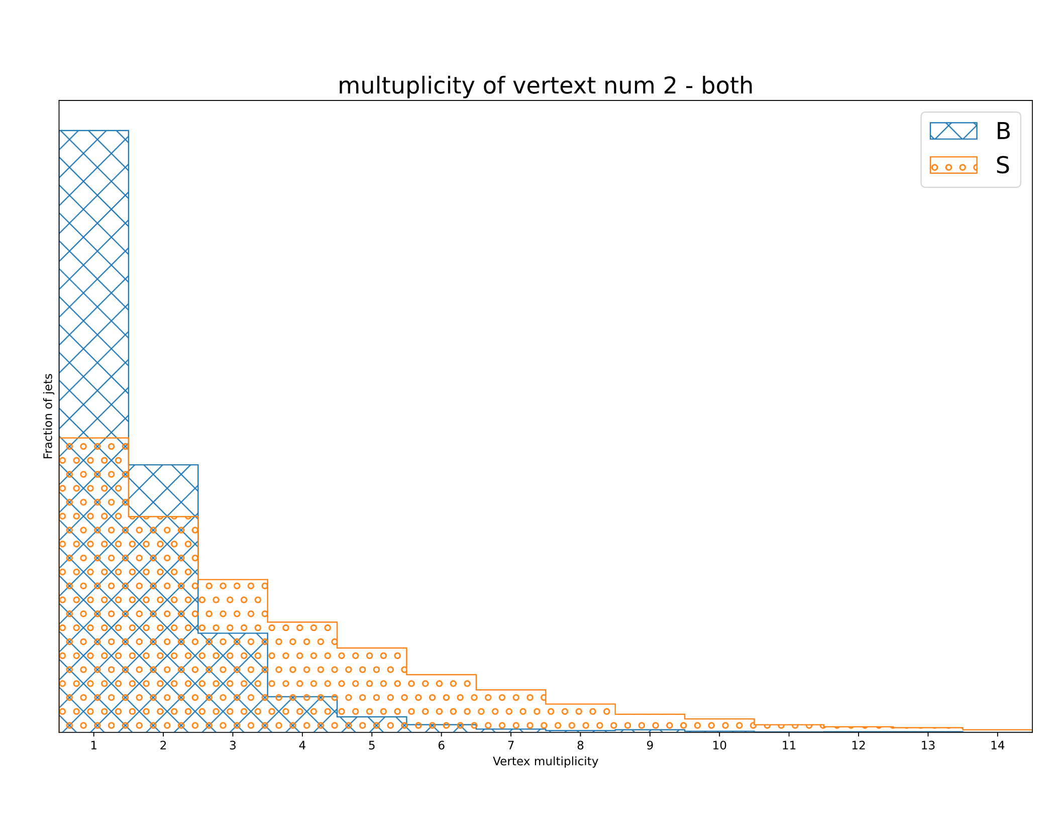
Secondary vertex multiplicity
1-2 tracks, larger tail for signal.

Slide 7
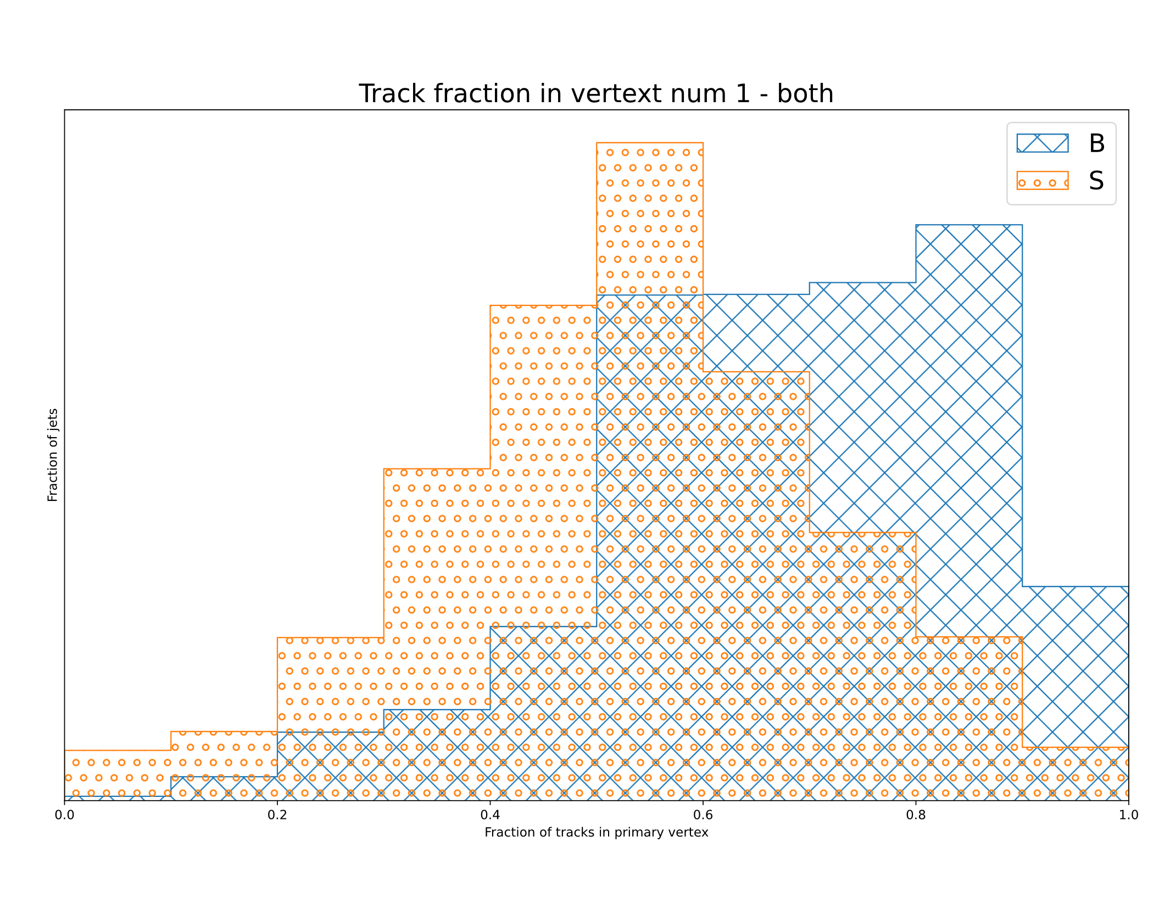
Fraction of jets in primary vertex
For signal ~50% of tracks in primary vertex whereas ~70% for background.

Slide 8
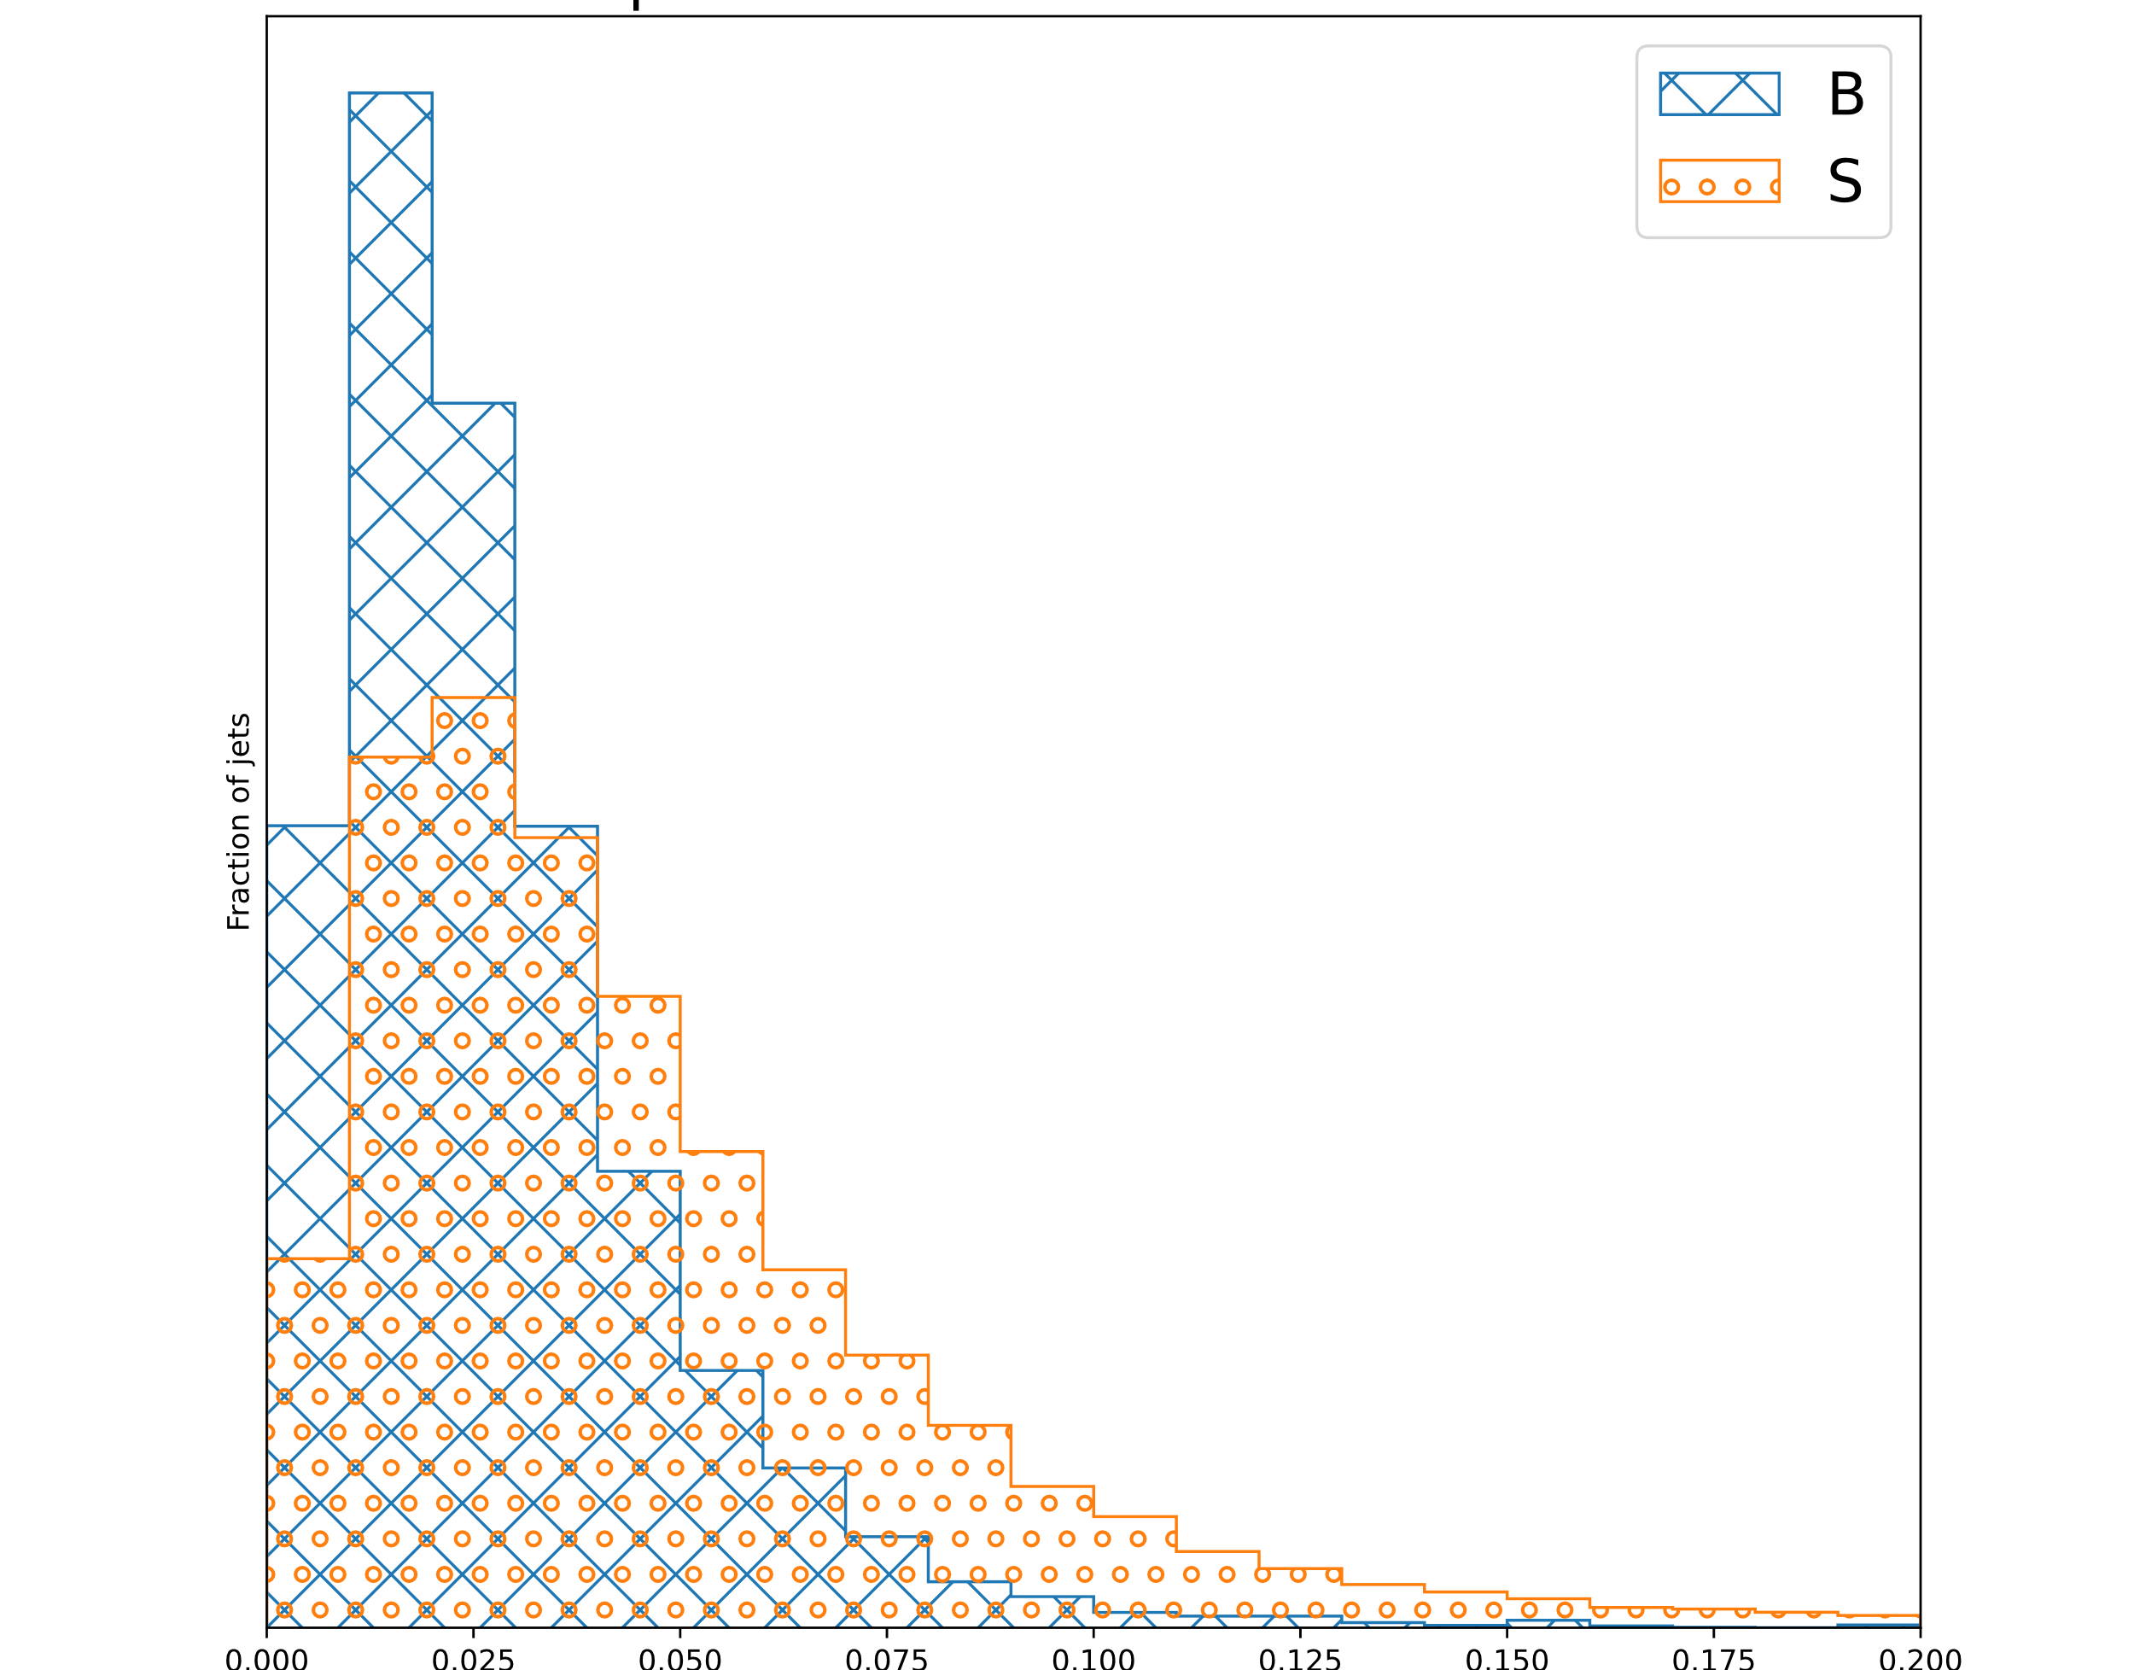
Primary vertex displacement
Signal slightly more displaced

Slide 9
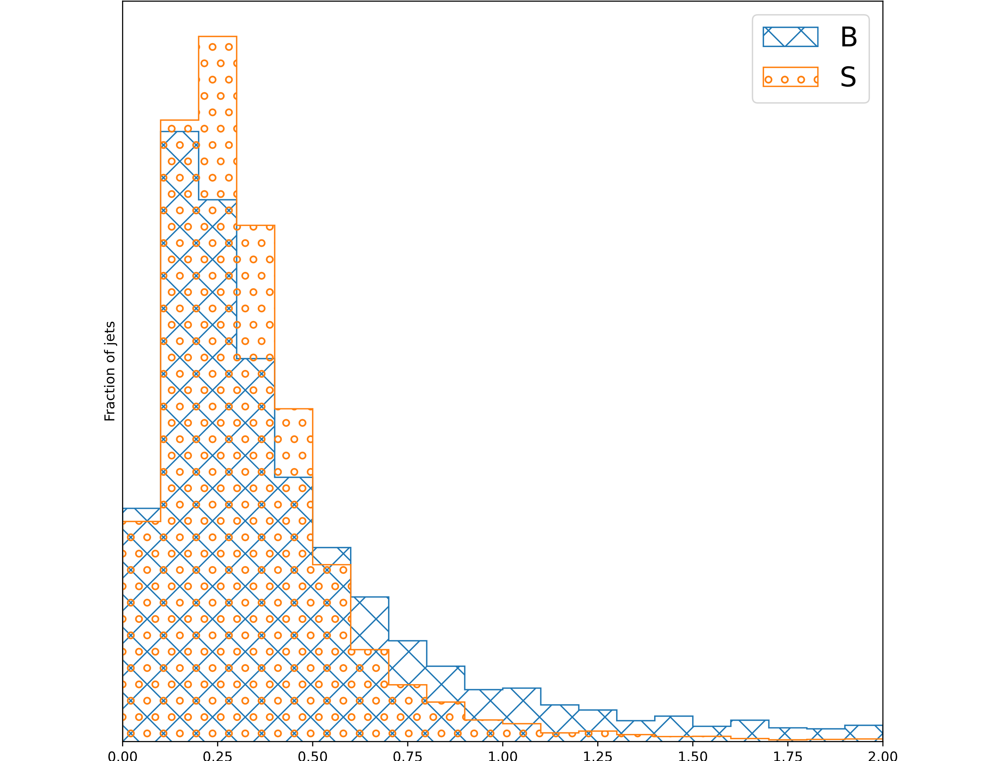
Secondary vertex displacement

Slide 10
Further questions
Should a cut be implemented on vertices?
Chisq cut?
Multiplicity cut?
Only vertices not shared by jets?

